Slide 2

ERWYN & EDMOND
🎓EVENT MANAGEMENT SYSTEM
BY TEAM ET

Slide 3
TEAM ET
OVERVIEW
INTRODUCTION
01
STORY
02
TARGET USER
03
DEVELOPMENT
04
WHAT NEXT?
05

Slide 4
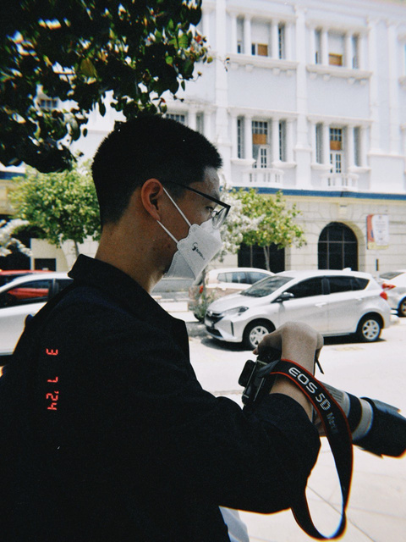

INTRODUCTION
OUR TEAM
The objective of our project is to develop a web-based platform that streamlines the process of organizing, registering, and checking into school events. By reducing reliance on paper-based processes, the system simplifies communication between event organizers and students, ultimately enhancing efficiency. Additionally, the platform aims to improve student participation by increasing visibility and accessibility of events. In terms of design, we adopted a modern glassmorphism user interface combined with a dark blue theme to reflect a sense of professionalism. Our focus was on creating a clean layout with intuitive navigation and ensuring mobile-friendliness to accommodate users on various devices.
ERWYN TAN
EDMOND TAN
FRONT-END DEVELOPER
&
CONTENT CREATOR
BACK-END DEVELOPER

Slide 5

PROBLEM
STORY
We didn’t know when or where they were happening
We forgot to register on time
We couldn’t find the right person to ask
It all began when our school had several amazing events—science fairs, club expos, and sports days—but students often didn’t know about them until it was too late.
Some events had low turnout, while others had confusing registration processes, like Google Forms shared in random WhatsApp groups or handwritten name lists.
SOLUTION
Upcoming Events page shows all event details in one place.
Register page allows quick and easy sign-up.
Website centralizes all event info — no need to ask around.
🤨Our team had an idea:
"What if everything was in one place?

Slide 6





TARGET USER
The targeted users of the School Event Management System are students , teachers and event organizers, who require a centralized, user-friendly platform to view upcoming events, register efficiently, and manage attendance. This system addresses common communication gaps by simplifying access to event information and reducing the reliance on physical announcements or manual coordination.

Slide 7


Languages
🖥️ HTML – Page structure
🎨 CSS – Styling with responsive design and glassmorphism
💡JavaScript – Interactivity (animations, UI effects)
⚙️ PHP + SQL– Event registration + attendance tracking
DEVELOPMENT
We used Visual Studio Code (VS Code) as our primary code editor to develop the website, allowing us to efficiently write, organize, and manage our HTML, CSS, JavaScript, and PHP files in a structured workspace.
AI Asisstences
Key Features
We used ChatGPT to assist us during development, helping us debug errors, generate code snippets, and improve the overall structure and functionality of our website.
📝 Event registration form (simple, clean, and accessible)
📅 Upcoming events list (animated cards with fade-in effect)
🌐 Consistent dark blue theme with glassmorphism cards
📱 Mobile-optimized layout

Slide 8

WHAT'S NEXT?
📸 QR Code Check-In System – Linked to student ID for fast attendance
📨 Email Notifications – Confirmations and reminders
📊 Dashboard – To view participation data
🌓 Dark/Light Mode Switch
📅 Calendar View – For quick monthly overviews

Slide 9
JUDGES LOGIN
STUDENT
ADMIN
username:
student
password:
admin123
username:
admin
password:
admin123

Slide 10
TUTORIAL
🧭 How to Use the Website – Step-by-Step Guide
1. When you first access the website, you’ll land on the Home Page.
2. Click on the "Explore Event" button to begin.
3. You’ll be redirected to the Login Page.
4. Enter the username and password provided in the previous slide.
5. After logging in successfully, you’ll be taken back to the Home Page.
6. Next, navigate to the Register page from the navigation bar.
7. Fill in the registration form with your event details and submit it.
8. A "Registration Successful" pop-up will appear to confirm your booking.
9. Finally, go to the Events page — you’ll see your booked event listed there.

Slide 11

ERWYN & EDMOND
THANK YOU

